Slide 1
CS5590 Applied Programming Series
Programming for Web/Cloud based Application

Slide 2
NodeJS and MongoDB
NodeJS modules and NPM

Slide 3

Overview
NodeJS modules
HTTP Module
URL Module
Events Module
File System Module
NPM Package for Modules
Upload Files/Formidable Module
MEAN Stack

Slide 4
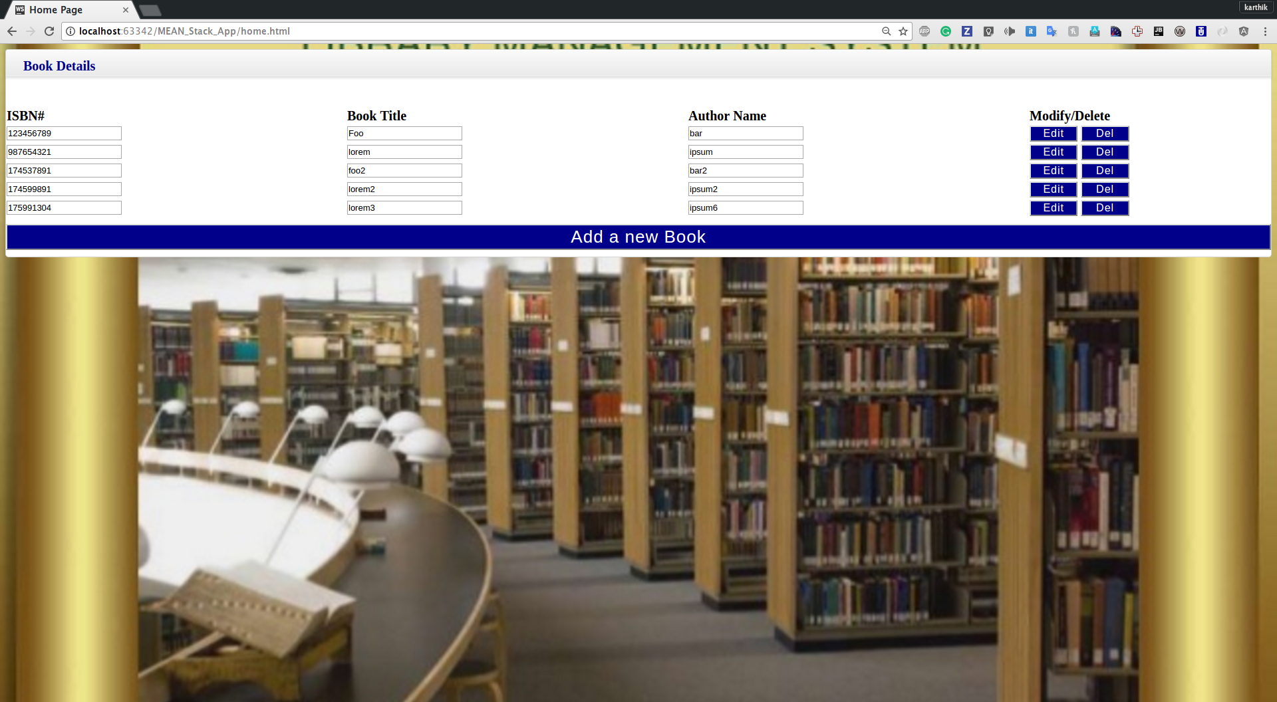
Use Case-Library management System

Slide 5
What is Node.js?
“Node.js is a platform built on Chrome's JavaScript runtime for easily building fast and scalable network applications. Node.js uses an event-driven, non-blocking I/O model that makes it lightweight and efficient, perfect for data-intensive real-time applications that run across distributed devices.” -The definition of Node.js as supplied by its official documentation
As an asynchronous event driven JavaScript runtime, Node is designed to build scalable network applications.
Node.js = Runtime Environment + JavaScript Library

Slide 6
Why Node.js?
Asynchronous and Event Driven
non - blocking calls & use of callbacks
Very Fast
built on Google Chrome's V8 JavaScript Engine
Single threaded
event looping
Highly Scalable
provides service to a larger number of requests than traditional servers like Apache HTTP Server
No Buffering
outputs the data in chunks

Slide 7
Why Node.js?
How PHP or ASP handles a file request:
Sends the task to the computer's file system.
Waits while the file system opens and reads the file.
Returns the content to the client.
Ready to handle the next request.
How Node.js handles a file request:
Sends the task to the computer's file system.
Ready to handle the next request.
When the file system has opened and read the file, the server returns the content to the client.

Slide 8
What Can Node.js Do?
Node.js can generate dynamic page content
Node.js can create, open, read from, write to , delete, and close files on the server
Node.js can collect form data
Node.js can add, delete, modify data in your database

Slide 9
Where to Use Node.js?
I/O bound Applications
Data Streaming Applications
Data Intensive Real-time Applications (DIRT)
JSON APIs based Applications
Single Page Applications

Slide 10
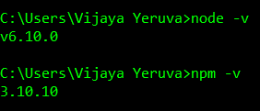
Node JS Installation
Install Node JS from https://nodejs.org/en/
Refer the Installation PPT
Check the installation with following commands
>node –v
>npm –v

Slide 11
Start with Node JS
Three Components of Node.js :
Import Required Modules (to load necessary modules)
Create Server (to handle client's requests similar to Apache HTTP Server)
Read request and return response (request came from browser and response back to same browser)
Running the Node.js application from command prompt
> node <name_of_js_file(example.js)>

Slide 12
Node.js Modules
Node.js Module is a set of functions you want to include in your application
Node.js has a set of built-in modules which you can use without any further installation
Users can create their own modules
To include a module, use the require() function with the name of the module:
Syntax: var http = require(‘<required module>');

Slide 13
A Few Built-in Modules and NPM
HTTP Module
URL Module
Events Module
File System Module
NPM Package for Modules
Upload Files/Formidable Module

Slide 14
HTTP Module
Allows Node.js to transfer data over the Hyper Text Transfer Protocol (HTTP)
The HTTP module can create a HTTP server that listens at server ports and gives a response back to the client

Slide 15
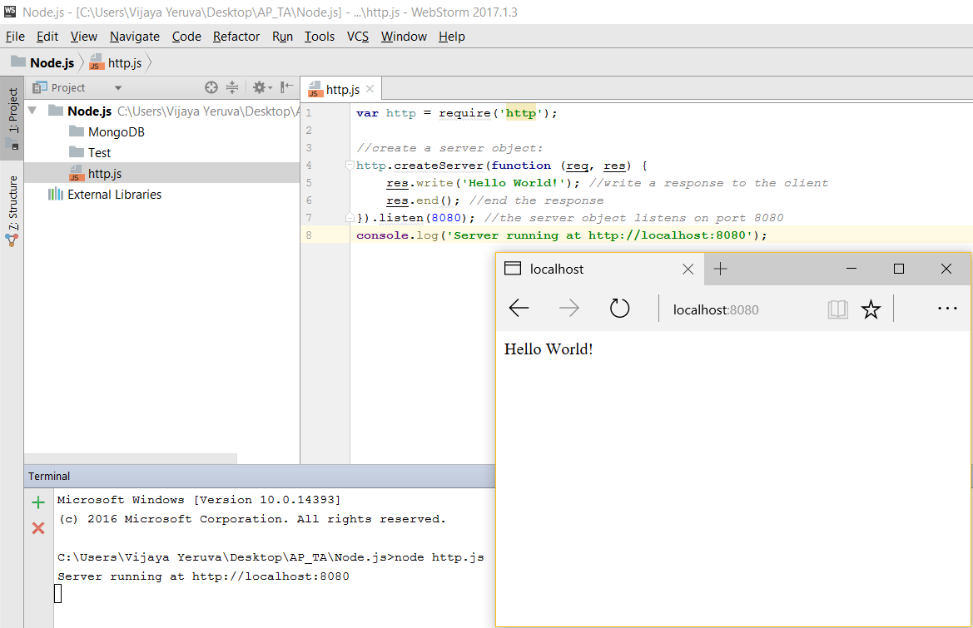
HTTP Module

Slide 16
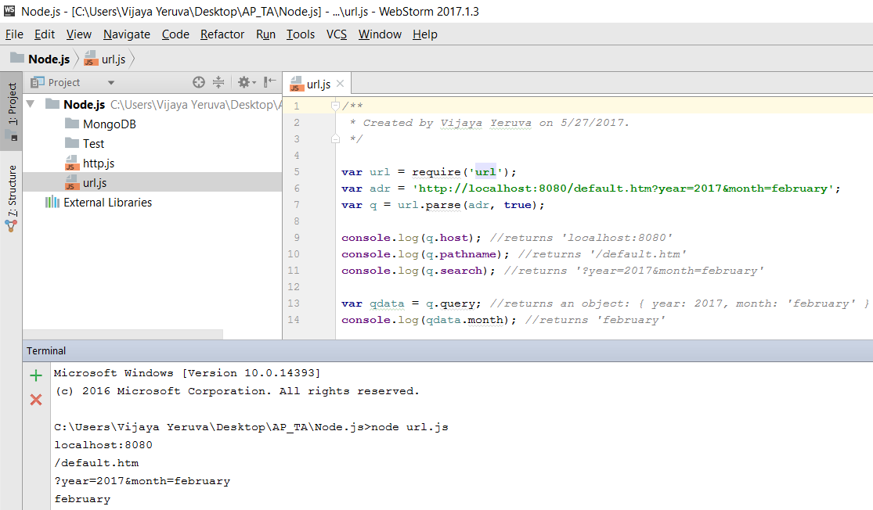
URL Module
splits up a web address into readable parts

Slide 17
Events Module
create, fire, and listen for your own events
In addition, all event properties and methods are an instance of an EventEmitter object. To be able to access these properties and methods, create an EventEmitter object
When the EventEmitter object emits an event, all of the functions attached to that specific event are called synchronously. Any values returned by the called listeners are ignored and will be discarded

Slide 18
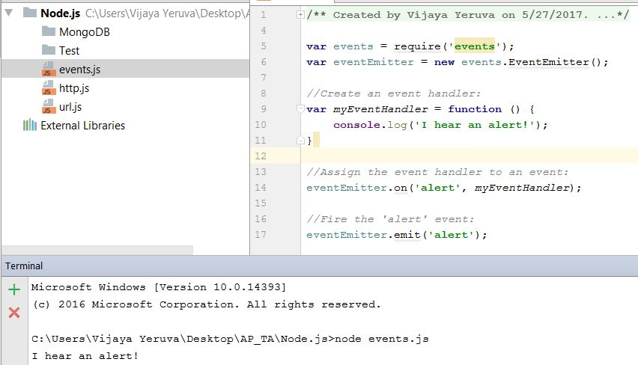
Events Module

Slide 19
File System Module
The Node.js file system module allow you to work with the file system on your computer
Common use for the File System module:
Read files
Create files
Update files
Delete files

Slide 20
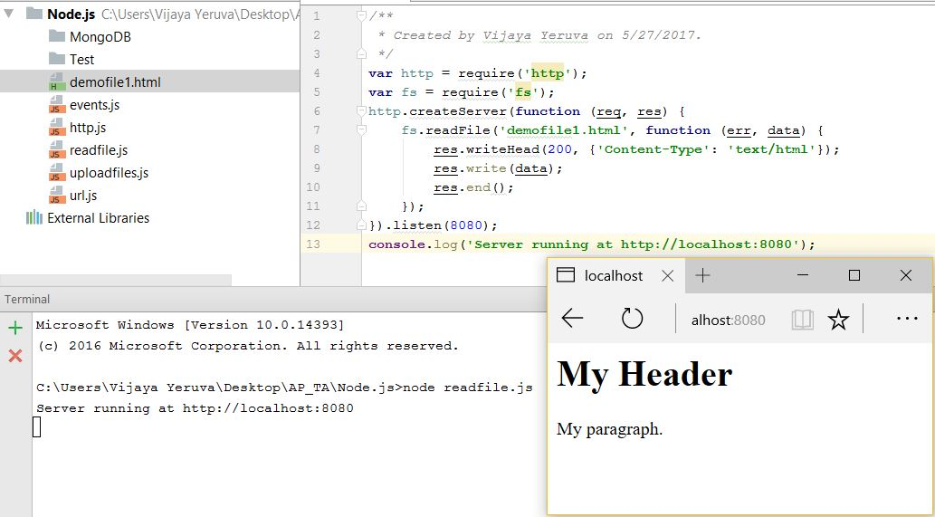
File System Module

Slide 21
NPM
NPM is a package manager for Node.js modules
www.npmjs.com hosts thousands of free packages to download and use
NPM makes it easy for JavaScript developers to share and reuse code, and it makes it easy to update the code that you're sharing
The NPM program is installed on your computer when you install Node.js

Slide 22
Download a NPM Package
To download particular package
<your project location>>npm install <package name>
Eg: C:\Users\Vijaya\project1>npm install upper-case
To download all available packages
<your project location>>npm install
Eg: C:\Users\Vijaya\project1>npm install

Slide 23
Express Framework
minimal and flexible Node.js web application framework for web and mobile apps
Allows to set up middlewares to respond to HTTP requests
Defines routing using actions and urls
Dynamically renders HTML pages based on passing arguments

Slide 24
References
https://www.w3schools.com/nodejs/default.asp
https://nodejs.org/en/
https://nodeschool.io/
https://www.tutorialspoint.com/nodejs/nodejs_introduction.htm

Slide 25
In class exercise
In the use case (explained in class), add update and delete functionality (user should able to update the employee details and user should able to delete the employee from data base)

